Slide 1
Creating Digital API Standards for the Entire Life Cycle of the LTL Shipment

Slide 2
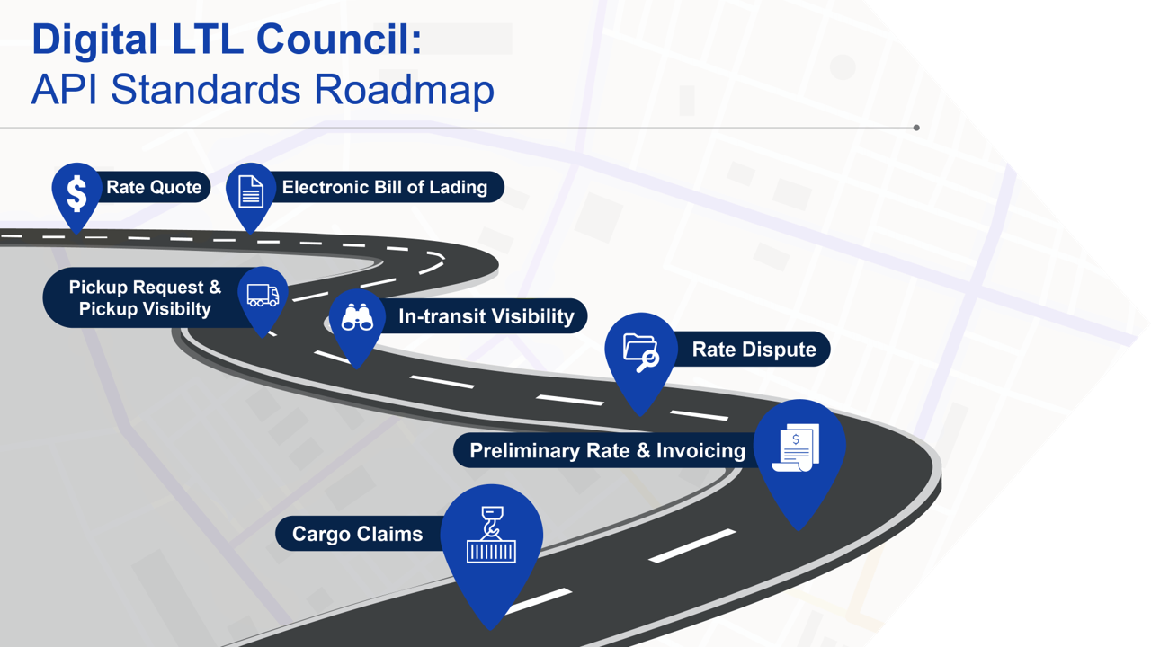
Digital LTL Council:
API Standards Roadmap

Slide 3

The Benefits of Digital API’s Accrue to the Carrier, the 3PL and the Shipper
Digitization improves service and lowers costs for all parties:
  Digital standards reduces the cost for carriers, shippers and 3PLs to onboard a new business partner.
  Fewer back office keystrokes lowers administrative cost by allowing carriers to auto bill and auto rate shipments.
  Fewer keystroke errors leads to more accurate billing, fewer misroutes. Downstream carriers incur fewer free astray shipments which improves service and lowers cost.
  Shippers and 3PL s gain improved visibility prior to pick up which leads to fewer customer service inquiries.
  Access to shipment bill of lading information earlier in the day leads to better planning which reduces a carrier’s
  cost to operate. Drivers spend less time inputting BOL information at pickup locations reducing stop time.
  Shippers and 3PLS gain access to real time service alerts when a shipment is delayed.
  Real time notification of price changes to the invoice (e.g. inspections, reweighs, delivery accessorials)
  lowers the cost to reconcile and approve invoices.
  Digitalization provides 3PLS and shippers with an opportunity to auto-resolve discrepancies
  between the initial quote and the final invoice.
  3PL’s spend less time on pro retrieval.

Slide 4
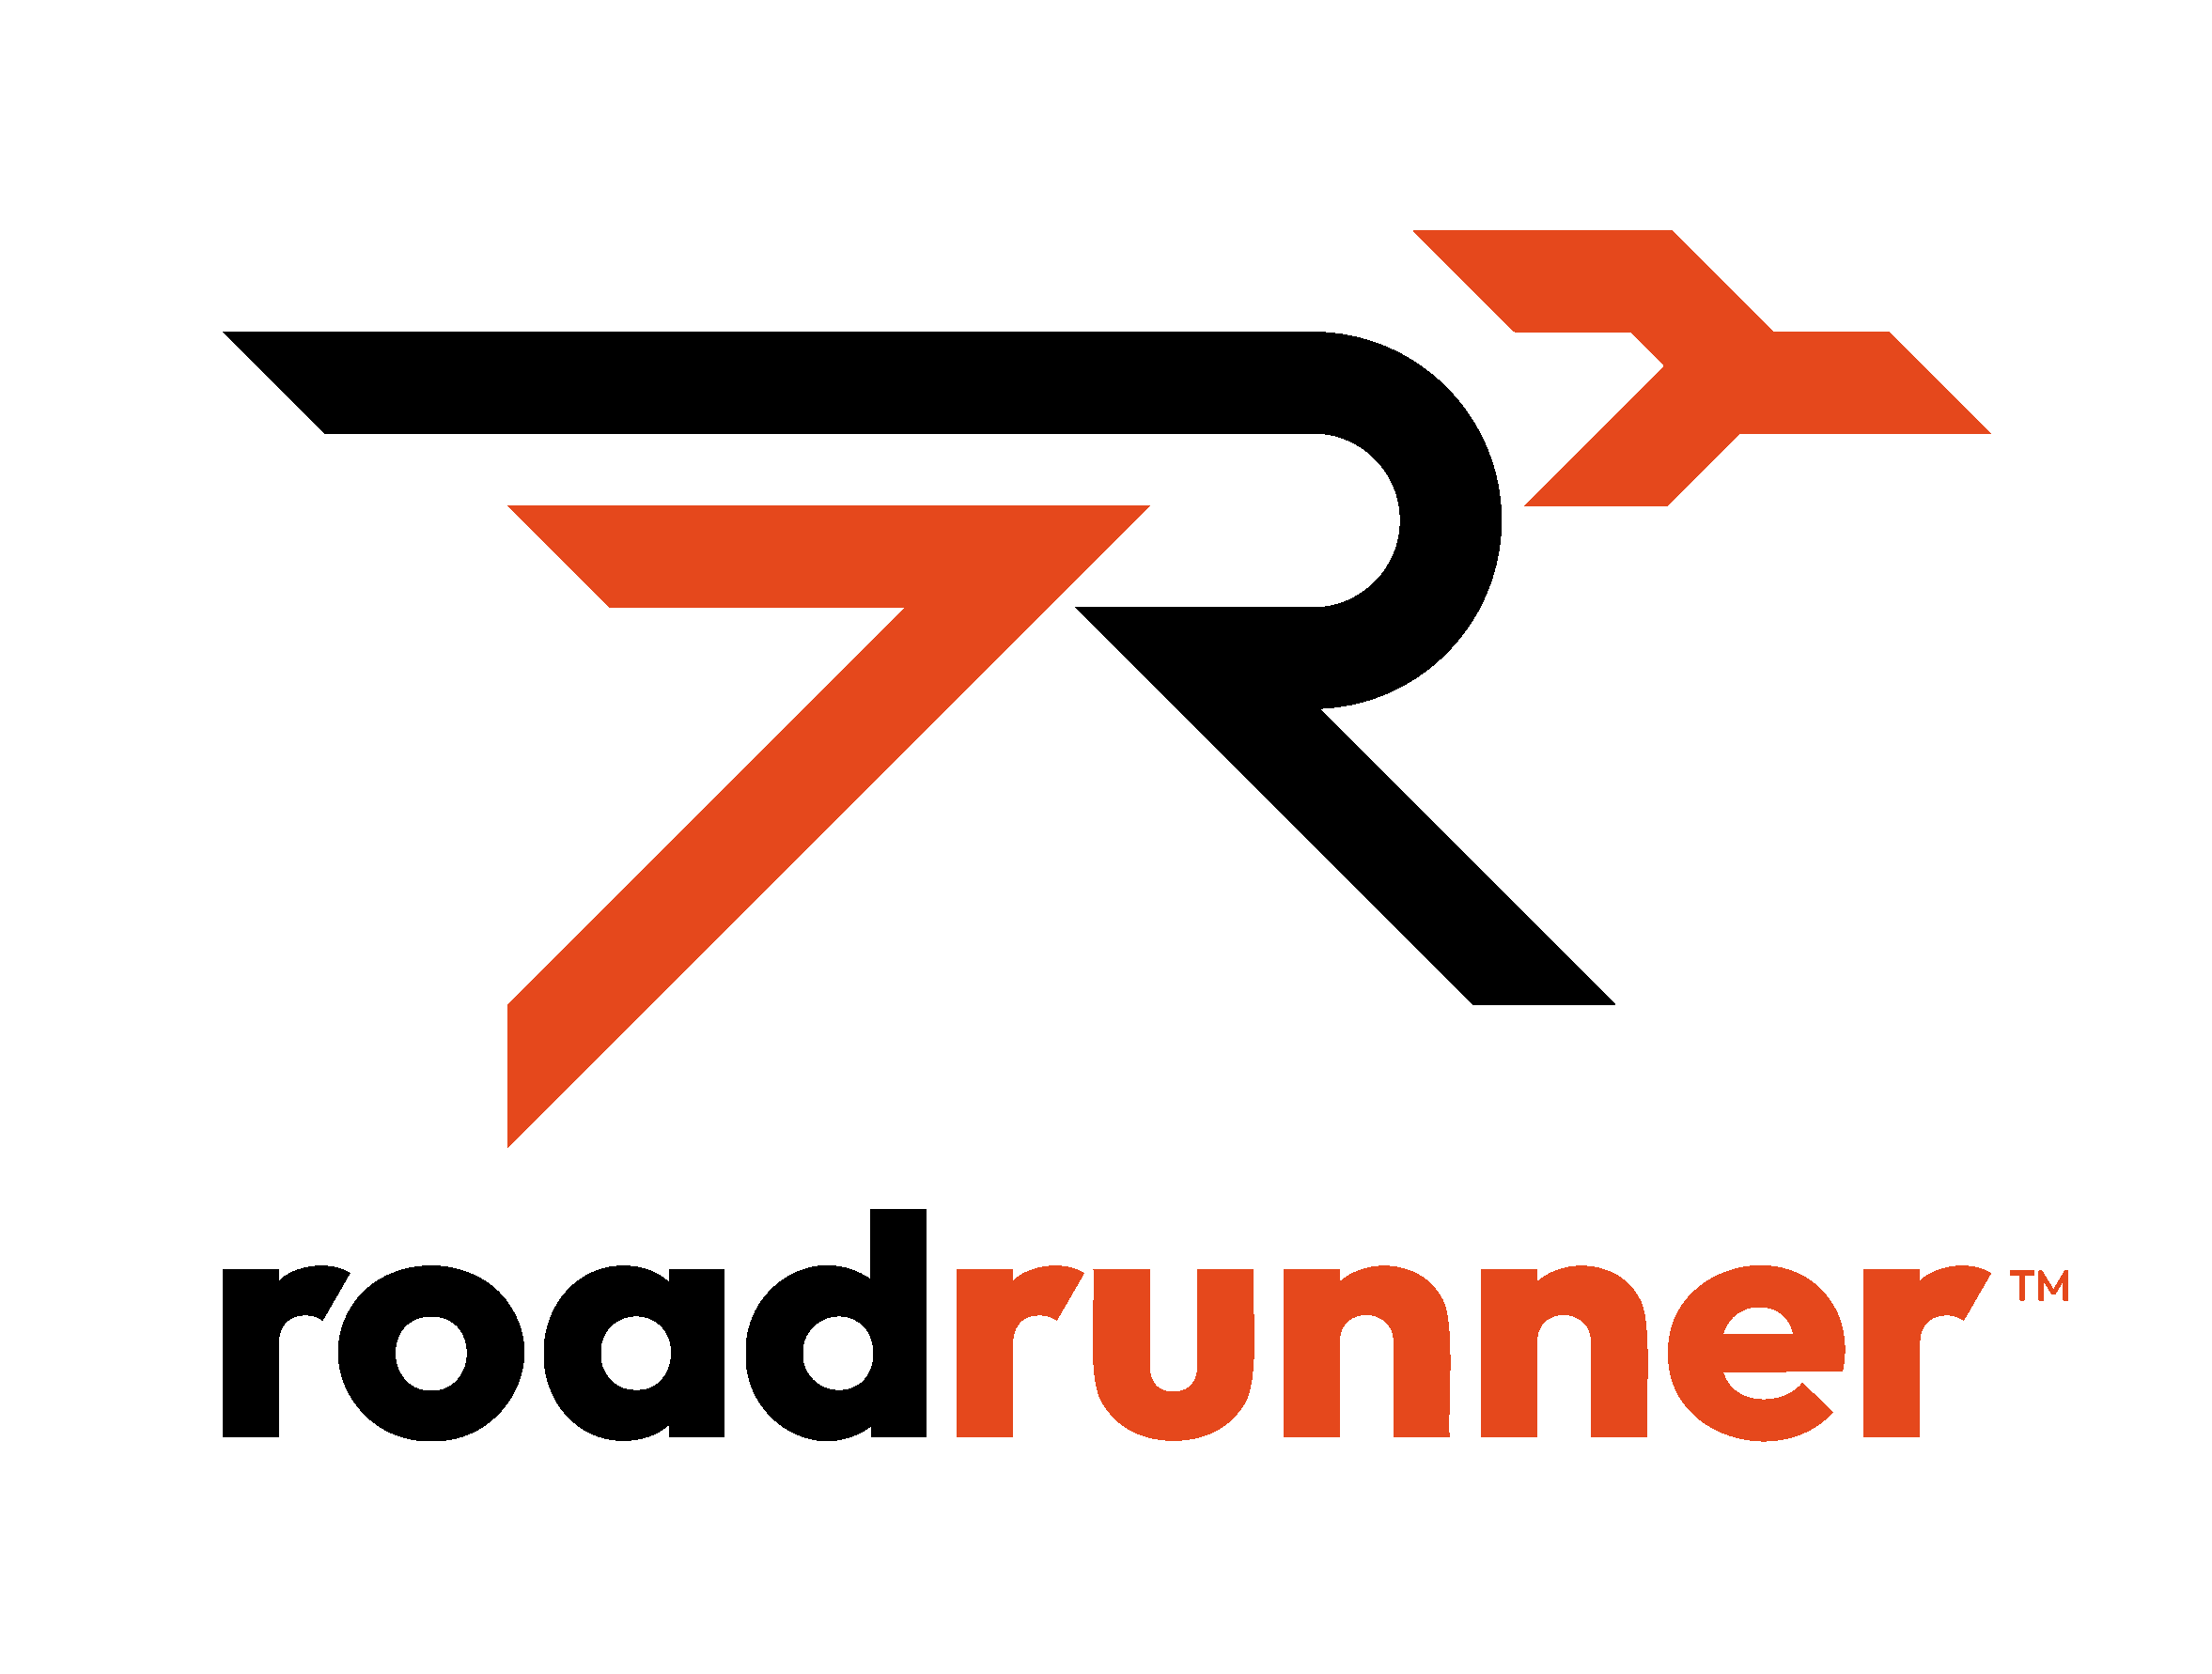


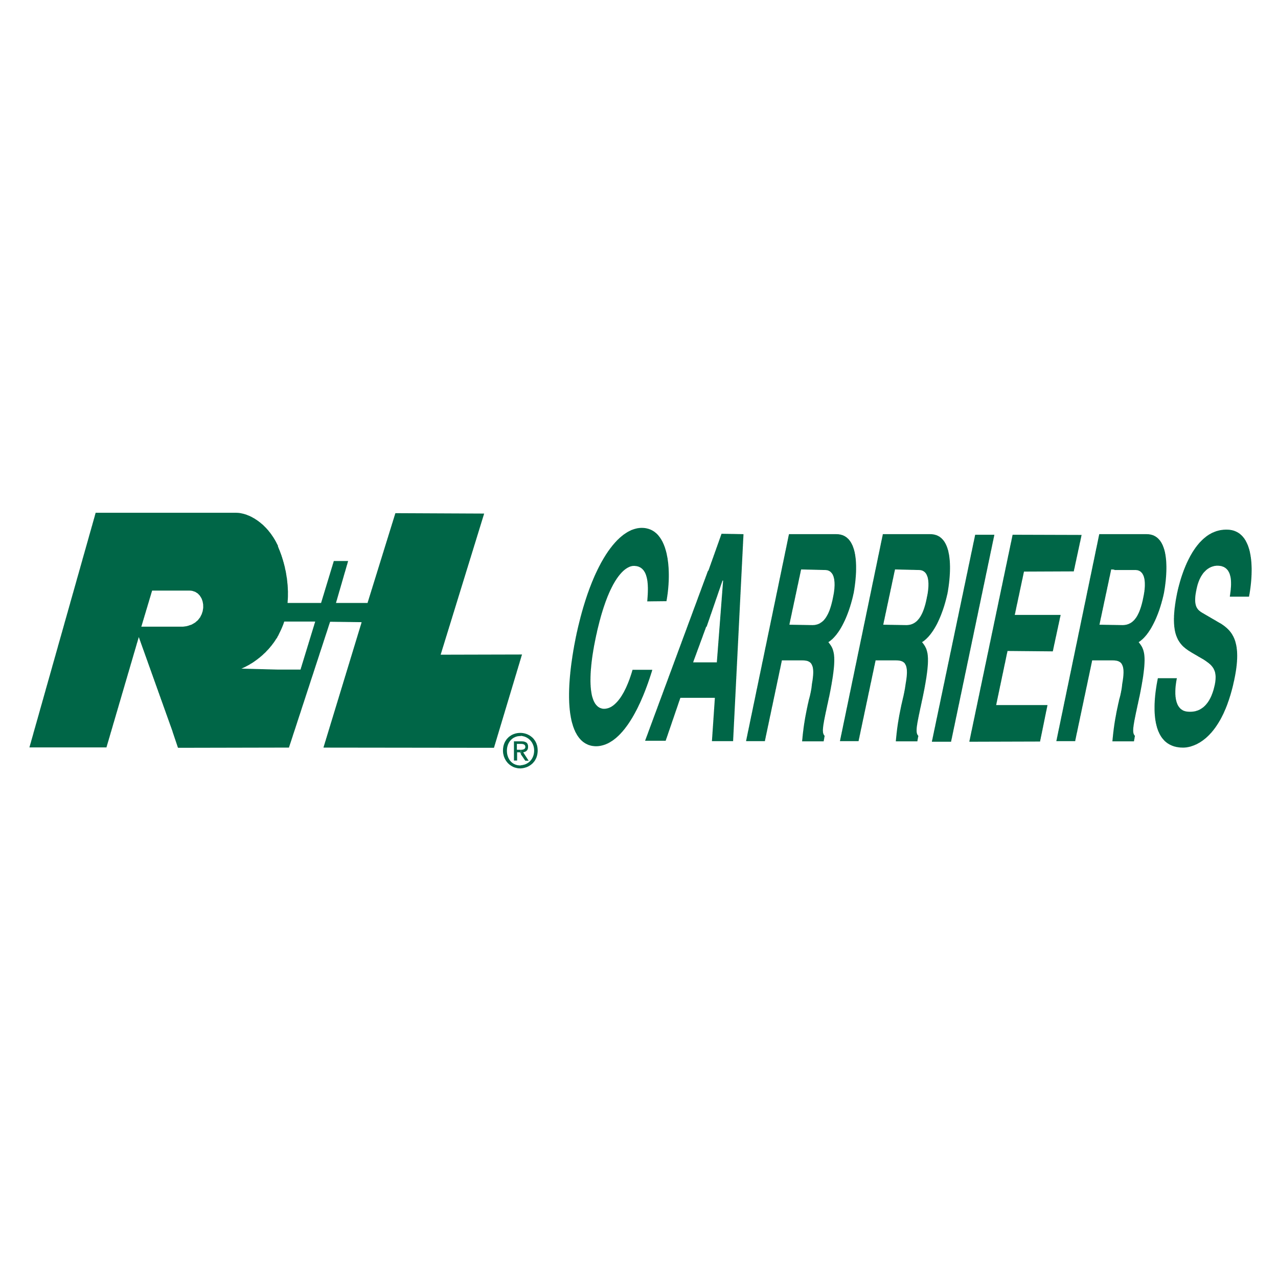

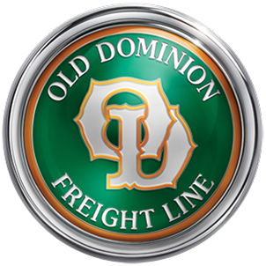


eBOL Fulfillment

Slide 5
eBOL Fulfillment
Rank | Pledged Carriers
3 | Yellow Corp
4 | XPO Logistics
7 | ABF Freight
9 | Saia Inc.
11 | Averitt Express
15 | AAA Cooper Transportation
17 | A. Duie Pyle Inc.
22 | Oak Harbor Freight Lines
24 | Ward Trucking
28 | Dependable Highway Express
29 | Peninsula Truck Lines
 | Represents 35% of Industry Revenue
Rank | Adopting Carriers
2 | Old Dominion Freight Line
5 | Estes Express Lines
6 | TFI International
8 | R & L Carriers
10 | Southeastern Freight Lines
13 | PITT OHIO Transportation Group
14 | Dayton Freight Lines
19 | Roadrunner Freight
 | Represents 37% Industry Revenue
Combined Total 72%

